Slide 1


Python Data Structure Basics

Slide 2
Agenda
What is python
What can python do
Python ranking
Why learn Python?
Basics of Python programming
Python data structure
Comparison operators
Python statements
Functions

Slide 3
What is Python?
Python is an open source, object-oriented, high-level powerful programming language.
Developed by Guido van Rossum in the early 1990s. Named after Monty Python
Python runs on many Unix variants, on the Mac, and on Windows 2000 and later.

Slide 4
What can Python do?
System utilities (system admin tools, command line programs)
Web Development
Graphical User Interfaces (Tkinter, gtk, Qt).
Internet scripting
Embedded scripting
Database access and programming
Game programming
Rapid prototyping and development
Distributed programming

Slide 5
Features of Python
Open source
Easy-to-learn
High-level Language: Python is an example of a high-level language like C, C++, Perl, and Java with lowlevel optimization
Portable
Object-Oriented: Python is a full-featured object-oriented programming language, with features such as classes, inheritance, objects, and overloading
Python is Interactive
Interpreted: Python programs are interpreted, takes source code as input, and then compiles (to portable byte-code) each statement and executes it immediately
Extendable: The Python interpreter is easily extended and can add a new built-in function or modules written in C/C++/Java code
Libraries
Supports

Slide 6

Organizations using python
It is a very popular language in multiple domains like Automation, Big Data, AI etc. You will also be impressed as it used by the vast multitude of companies around the globe.

Slide 7
Python Syntax compared to other programming languages
Python was designed to for readability and has some similarities to the English language with influence from mathematics.
Python uses new lines to complete a command, as opposed to other programming languages which often use semicolons or parentheses.
Python relies on indentation, using whitespace, to define scope; such as the scope of loops, functions and classes. Other programming languages often use curly-brackets for this purpose.

Slide 8
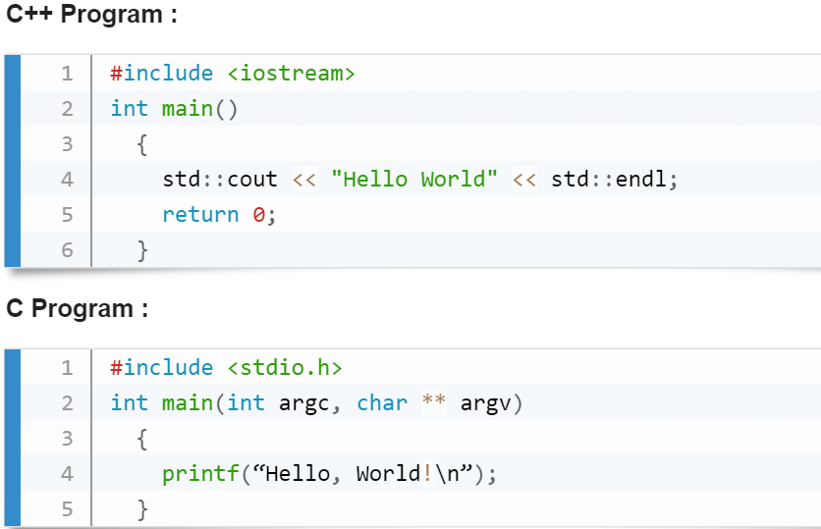
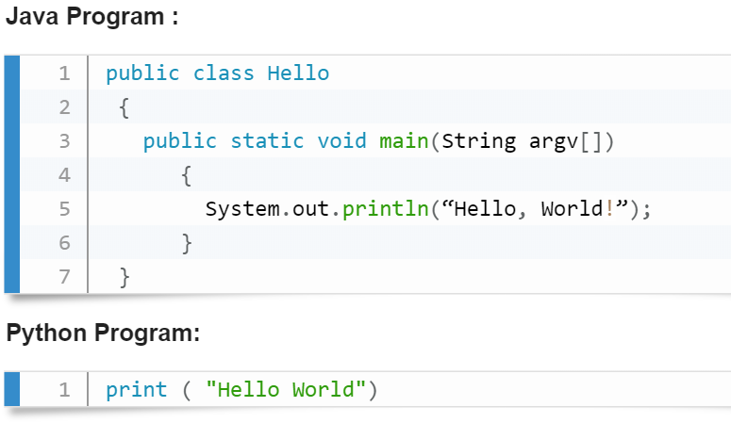
Python Syntax compared to other programming languages

Slide 9
Python 2.x VS Python 3.x
Syntax | Python 2 | Python 3
print statement vs. print function | print "Hello World" | print("Hello World")
range and xrange | range(1, 10) [1, 2, 3, 4, 5, 6, 7, 8, 9] | range(1, 10) range(1, 10) no xrange
Raising and handling Exceptions | [3, 5] > 'xyz’ False | list() > str()
Comparison of unorderable types | print "[2, 3]>'xyz'= ", [2, 3]>'xyz' [2, 3]>'xyz' = False | list() > str()
bytes vs string | >>> a = "Python" >>> len(a) | To treat a string as a sequence of bytes, you need to cast: >>> a = bytes("Python", "utf-8")
Integer division | >>> print "6//3 =", 6//3 6//3 = 2 | >>> print("6/3 =", 6/3) 6/3 = 2.0
dictionary method | dict.iteritems(): Return an iterator over the dictionary's (key, value) pairs | dict.items(): Return a copy of the dictionary’s list of (key, value) pairs.
Data Input | >>>data_input2 = raw_input() | >>>data_input3 = input()

Slide 10
Python Reserve words:
False | class | finally | is | return
None | continue | for | lambda | try
True | def | from | nonlocal | while
and | del | global | not | with
as | el | if | or | yield
assert | else | import | pass
break | except | in | raise

Slide 11
Variable and Value
A variable is a memory location where a programmer can store a value. Example : roll_no, amount, name etc.
Value is either string, numeric etc. Example : "Sara", 120, 25.36
Variables are created when first assigned.
Variables must be assigned before being referenced.
The value stored in a variable can be accessed or updated later.
No declaration required
The type (string, int, float etc.) of the variable is determined by Python
The interpreter allocates memory on the basis of the data type of a variable.

Slide 12
Python Variable Name Rules
Must begin with a letter (a - z, A - B) or underscore (_)
Other characters can be letters, numbers or _
Case Sensitive
Can be any (reasonable) length
There are some reserved words which you cannot use as a variable name because Python uses them for other things.

Slide 13
Good Variable Name
Choose meaningful name instead of short name. roll_no is better than rn.
Maintain the length of a variable name. Roll_no_of_a-student is too long?
Be consistent; roll_no or RollNo
Begin a variable name with an underscore(_) character for a special case

Slide 14
Python Assignment Statements
The assignment statement creates new variables and gives them values. Basic assignment statement in Python is :
Item_name = "Computer" #A String
Item_qty = 10 #An Integer
Item_value = 1000.23 #A floating point
print (Item_name)
print (Item_qty)
print (Item_value)

Slide 15
Local and global variables in Python
Variables that are only referenced inside a function are implicitly global. If a variable is assigned a value anywhere within the function’s body, it’s assumed to be a local unless explicitly declared as global.
var1 = "Python"
def func1():
var1 = "PHP"
print("In side func1() var1 = ",var1)
def func2():
print("In side func2() var1 = ",var1)
func1()
func2()

Slide 16
Local and global variables in Python
We can use a global variable in other functions by declaring it as global keyword :
def func1():
global var1
var1 = "Python"
print("In side func1() var1 = ",var1)
def func2():
print("In side func2() var1 = ",var1)
func1()
func2()

Slide 17
Python Data Type
Type represents the kind of value and determines how the value can be used
All data values in Python are encapsulated in relevant object classes, Everything in Python is an object and every object has an identity, a type, and a value
Python has three distinct numeric types: integers, floating point numbers, and complex numbers, Booleans are a subtype of plain integers.
x = 212
y = 12.6
z = complex(1,2)
name = ("Hello World")
var_bol= True
print (type(x))
print (type(y))
print (type(z))
print (type(name))
print(type(var_bol))

Slide 18
Strings
In Python, a string type object is a sequence (left-to- right order) of characters. Strings start and end with single or double quotes Python strings are immutable
mystr = "Python String"
mystr1 = "Second String"
print (mystr)
print (mystr1)
print(type(mystr))
print(type(mystr1))

Slide 19
Special characters in strings
The backslash (\) character is used to introduce a special character. See the following table.
Escape sequence | Meaning
\n | Newline
\t | Horizontal Tab
\\ | Backslash
\' | Single Quote
\" | Double Quote

Slide 20
Example
print ("There is a (\\) in this line") #Giving backslash
print ("This is \t in the line") #Giving tab space in the line
print ("These are \'single quotes\' in this line") #using single quotes
print ("these are the \"double quotes\" in the line")
print ("there is a \n new line in this string")

Slide 21
String indices and accessing string elements
Strings are arrays of characters and elements of an array can be accessed using indexing. Indices start with 0 from left side and -1 when starting from right side.
my_str = "PYTHON ROCKS"
print (my_str)
print(len(my_str))
print(my_str[0])
print(my_str[-11])
character | P | Y | T | H | O | N |  | R | O | C | K | S
Index from left | 0 | 1 | 2 | 3 | 4 | 5 | 6 | 7 | 8 | 9 | 10 | 11
Index from right | -12 | -11 | -10 | -9 | -8 | -7 | -6 | -5 | -4 | -3 | -2 | -1

Slide 22
Strings are immutable
Strings are immutable character sets. Once a string is generated, you can not change any character within the string.
my_str = "PYTHON ROCKS"
print(my_str[0])
# Will not work
my_str[0]="M"

Slide 23
'in' operator in Strings
The 'in' operator is used to check whether a character or a substring is present in a string or not. The expression returns a Boolean value.
my_str = "PYTHON ROCKS"
print(my_str[1])
print("Y" in my_str)
print("A" in my_str)
print("ROCKS" in my_str)

Slide 24
String Slicing
To cut a substring from a string is called string slicing.
Here two indices are used separated by a colon (:). A slice 3:7 means indices characters of 3rd, 4th, 5th and 6th positions.
my_str = "PYTHON ROCKS"
print(len(my_str))
print(my_str[0:7])
print(my_str[-12:-1])
print(my_str[-12:])
print(my_str[-12:-6])

Slide 25
Tuples
A tuple is a container which holds a series of comma-separated values (items or elements) between parentheses. Indexing and slicing are same in tuples as strings
Tuples are immutable (i.e. you cannot change its content once created) and can hold mix data types.
mytup1=(12,25.4,"PYTHON",212)
mytup2=(-21,224,87.6,"Hello",22)
print(mytup1)
print(len(mytup1))
print(type(mytup1))
print(mytup2)
print(len(mytup2))
print(type(mytup2))
#To create empty or single element tuple
emptup = ()
print(type(emptup))
print(emptup)
onetup = (212,)
print(type(onetup))
print(onetup)

Slide 26
+ and * operators in Tuples
Use + operator to create a new tuple that is a concatenation of tuples and use * operator to repeat a tuple.
mytup1=(12,25.4,"PYTHON", 212)
mytup2=(-21,224,87.6, "Hello" ,22, "World")
print(mytup1)
#using + operator
newtup=mytup1+mytup2
print(newtup)
print(len(newtup))
#using * operator
newtup1=mytup1*4
print(newtup1)
print(len(newtup1))

Slide 27
Lists
Collection of values
Contain any data type
Contain different data types and lists also within the list
As opposed to int, bool etc, a list is a compound data type: you can group values together:
a = "is"
b = "nice"
my_list = ["my", "list", a, b]
# area variables (in square meters)
hall = 11.25 kit = 18.0 liv = 20.0 bed = 10.75 bath = 9.50
# Create list areas
areas=[hall, kit, liv, bed, bath]
# Print areas
print(areas)

Slide 28
Create list with different types
A list can also contain a mix of Python types including strings, floats, booleans, etc.
create the areas list such that the list first contains the name of each room as a string, and then its area. More specifically, add the strings "hallway", "kitchen" and "bedroom" at the appropriate locations.
# area variables (in square meters)
hall = 11.25 kit = 18.0 liv = 20.0 bed = 10.75 bath = 9.50
# Adapt list areas
areas = ["hallway",hall, "kitchen", kit, "living room", liv, "bedroom", bed, "bathroom", bath]
# Print areas
print(areas)

Slide 29
List of lists
Instead of creating a flat list containing strings and floats, representing the names and areas of the rooms in your house, you can create a list of lists.
Finish the list of lists so that it also contains the bedroom and bathroom data. Make sure you enter these in order!
Print out house; does this way of structuring your data make more sense?
Print out the type of house. Are you still dealing with a list?
# area variables (in square meters)
hall = 11.25 kit = 18.0 liv = 20.0 bed = 10.75 bath = 9.50
# house information as list of lists
house = [["hallway", hall], ["kitchen", kit], ["living room", liv], ["bedroom", bed], ["bathroom", bath]]
# Print out house
print(house)
# Print out the type of house
print(type(house))

Slide 30
Subsetting Lists
# Create the areas list
areas = ["hallway", 11.25, "kitchen", 18.0, "living room", 20.0, "bedroom", 10.75, "bathroom", 9.50]
Print out the second element from the areas list, so 11.25.
Subset and print out the last element of areas, being 9.50. Using a negative index makes sense here!
# Print out second element from areas
print(areas[1])
# Print out last element from areas
print(areas[-1])
# Print out the area of the living room
print(areas[5])

Slide 31
Subset and calculate
After you've extracted values from a list, you can use them to perform additional calculations. Take this example, where the second and fourth element of a list x are extracted. The strings that result are pasted together using the + operator:
x = ["a", "b", "c", "d"]
print(x[1] + x[3])
# Create the areas list
areas = ["hallway", 11.25, "kitchen", 18.0, "living room", 20.0, "bedroom", 10.75, "bathroom", 9.50]
# Sum of kitchen and bedroom area: eat_sleep_area eat_sleep_area=areas[3]+areas[7]
# Print the variable eat_sleep_area print(eat_sleep_area)

Slide 32
Slicing and dicing
Selecting single values from a list is just one part of the story. It's also possible to slice your list, which means selecting multiple elements from your list. Use the following syntax:
my_list[start:end]
The start index will be included, while the end index is not.
The code sample below shows an example. A list with "b" and "c", corresponding to indexes 1 and 2, are selected from a list x:
x = ["a", "b", "c", "d"]
x[1:3]
The elements with index 1 and 2 are included, while the element with index 3 is not.

Slide 33
Slicing and dicing
# Create the areas list
areas = ["hallway", 11.25, "kitchen", 18.0, "living room", 20.0, "bedroom", 10.75, "bathroom", 9.50]
# Use slicing to create downstairs for first 6 elements downstairs=areas[0:6]
# Use slicing to create upstairs for last 4 elements
upstairs=areas[6:10]
# Print out downstairs and upstairs print(downstairs)
print(upstairs)

Slide 34
Slicing and dicing
Use slicing to create the lists downstairs and upstairs again, but this time without using indexes if it's not necessary. Remember downstairs is the first 6 elements of areas and upstairs is the last 4 elements of areas.
# Create the areas list
areas = ["hallway", 11.25, "kitchen", 18.0, "living room", 20.0, "bedroom", 10.75, "bathroom", 9.50]
# Alternative slicing to create downstairs
downstairs = areas[:6]
# Alternative slicing to create upstairs
upstairs = areas[-4:]

Slide 35
List Manipulation
Change elements of the list
Add and remove list of the list

Slide 36
Replace list elements
Use the IPython Shell to experiment with the commands below. Can you tell what's happening and why?
x = ["a", "b", "c", "d"]
x[1] = "r"
x[2:] = ["s", "t"]
For this and the following exercises, you'll continue working on the areas list that contains the names and areas of different rooms in a house.
x=['a', 'r', 's', 't']

Slide 37
Replace list elements
# Create the areas list
areas = ["hallway", 11.25, "kitchen", 18.0, "living room", 20.0, "bedroom", 10.75, "bathroom", 9.50]
# Correct the bathroom area to 10.50
areas[-1]=10.50
# Change "living room" to "chill zone" areas[4]="chill zone"

Slide 38
Extend a list
If you can change elements in a list, you sure want to be able to add elements to it, right? You can use the + operator:
x = ["a", "b", "c", "d"]
y = x + ["e", "f"]
You just won the lottery, awesome! You decide to build a poolhouse and a garage. Can you add the information to the areas list?

Slide 39
Extend a list
# Create the areas list and make some changes
areas = ["hallway", 11.25, "kitchen", 18.0, "chill zone", 20.0, "bedroom", 10.75, "bathroom", 10.50]
Use the + operator to paste the list ["poolhouse", 24.5] to the end of the areas list. Store the resulting list as areas_1.
# Add poolhouse data to areas, new list is areas_1 areas1=areas+["poolhouse",24.5]
Further extend areas_1 by adding data on your garage. Add the string "garage" and float 15.45. Name the resulting list areas_2.
# Add garage data to areas_1, new list is areas_2 areas2=areas1+["garage",15.45]

Slide 40
Explicit copy of list
Change the second command, that creates the variable areas_copy, such that areas_copy is an explicit copy of areas
# Create list areas
areas = [11.25, 18.0, 20.0, 10.75, 9.50] # Create areas_copy
areas_copy = areas[:] #or
areas_copy = list(areas)
# Change areas_copy
areas_copy[0] = 5.0
# Print areas
print(areas)

Slide 41
Comparison operators in Python
Comparison operators, also known as relational operators in Python, compare the values on either side of them and returns a boolean value.
They tell whether a statement is True or False according to the condition.
List of comparison operators in Python
Greater than (>)
Less than (<)
Equal to (==)
Not equal to (!=)
Greater than or equal to (>=)
Less than or equal to (<=)

Slide 42
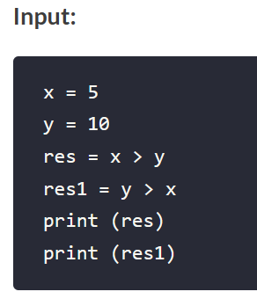
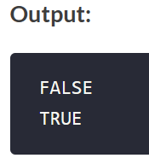
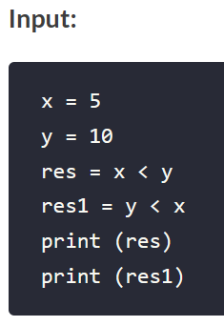
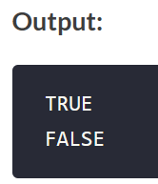
Comparison operators in Python
Greater than Denoted by >, the greater than operator checks if the value on the left side is greater than the value on the right side. It returns True if the condition is satisfied, otherwise returns False.
Less than
The less than operator is denoted by < sign and compares the values present on either side. If the value present on the left side is smaller than the value on the right side, it returns True otherwise it returns False.

Slide 43
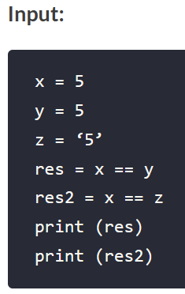
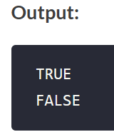
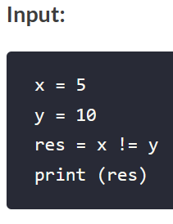
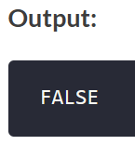
Comparison operators in Python
Equal to
This operator is denoted by == and it returns True if both the values present on either side are equal.
Not equal to
Symbolic representation of Not equal to operator is != and it returns True if one value is not equal to the other present in the condition.

Slide 44
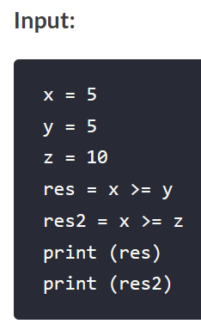
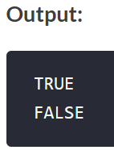
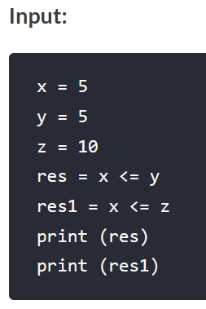
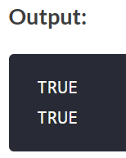
Comparison operators in Python
Greater than or equal to
This operator (>=) only returns True if the value on the left side is greater or equal to the value on the right side.
Less than or equal to
The last operator in the list is less than or equal to (<=). It compares the values and returns True if the value on the left side is smaller than or equal to the value to the value on the right side.

Slide 45
Python Statements
A statement is an instruction that a Python interpreter can execute.
There are mainly four types of statements in Python.
print statements
Assignment statements
Conditional statements
Looping statements.
The print and assignment statements are commonly used. The result of a print statement is a value. Assignment statements don’t produce a result it just assigns a value to the operand on its left side.

Slide 46
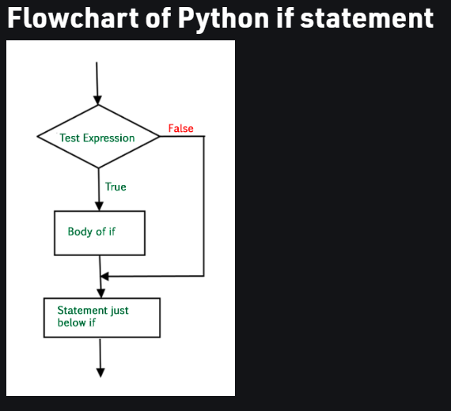
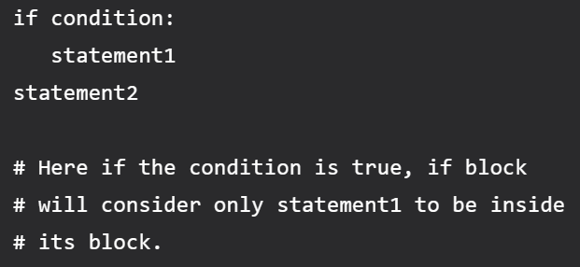
Conditional Statements
if statement
if statement is the most simple decision-making statement. It is used to decide whether a certain statement or block of statements will be executed or not i.e if a certain condition is true then a block of statement is executed otherwise not.
Python uses indentation to identify a block.

Slide 47
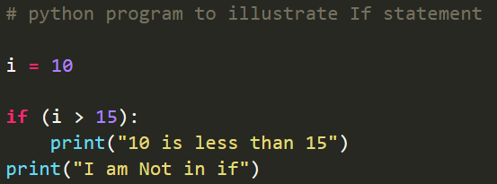
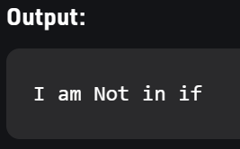
Example of if statement

Slide 48
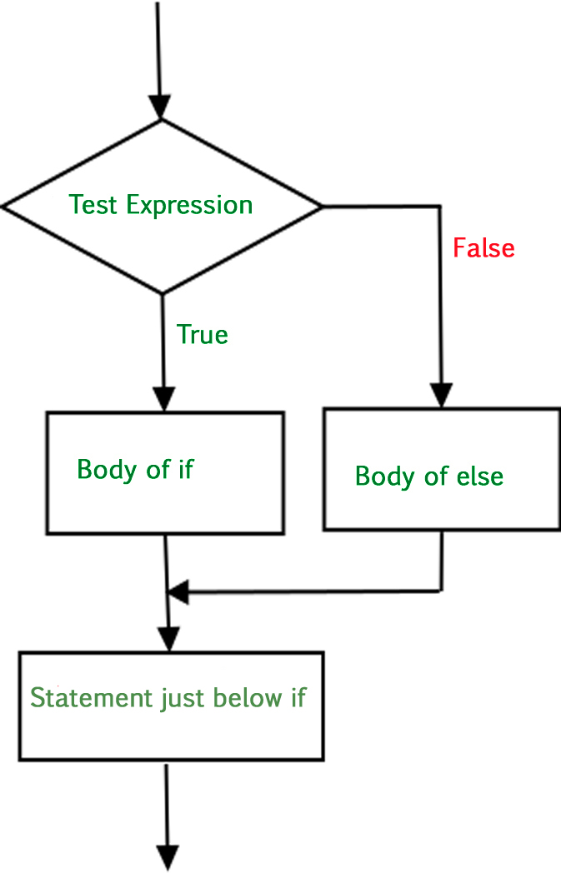
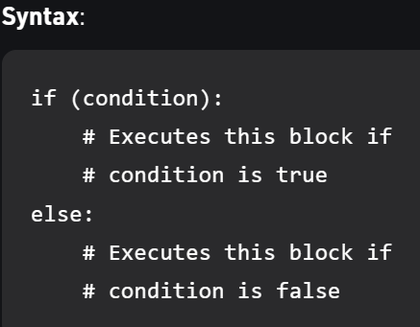
If-else statements
The if statement alone tells us that if a condition is true it will execute a block of statements and if the condition is false it won’t. But what if we want to do something else if the condition is false.
Use the else statement with if statement to execute a block of code when the condition is false.

Slide 49
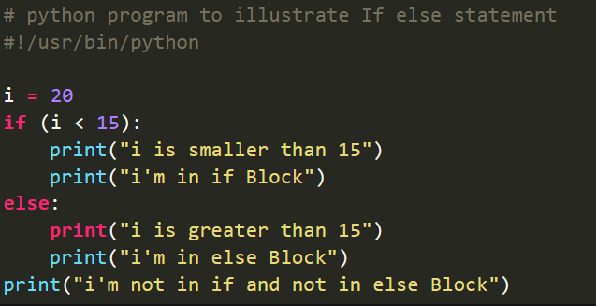
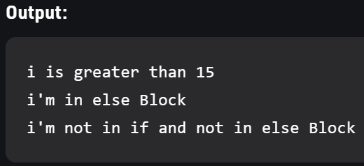
Example of if-else statement

Slide 50
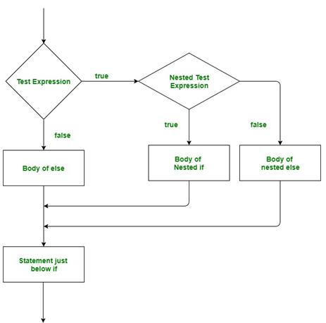
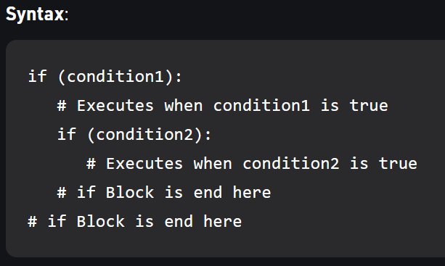
Nested-if statement
Nested if statements mean an if statement inside another if statement.

Slide 51
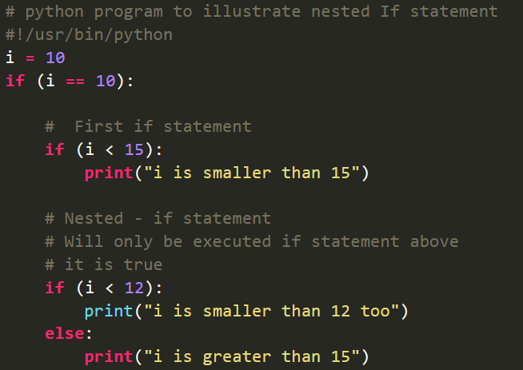
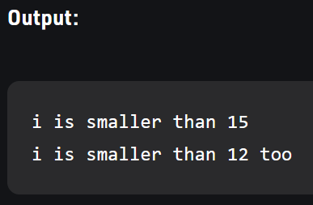
Example of Nested if

Slide 52
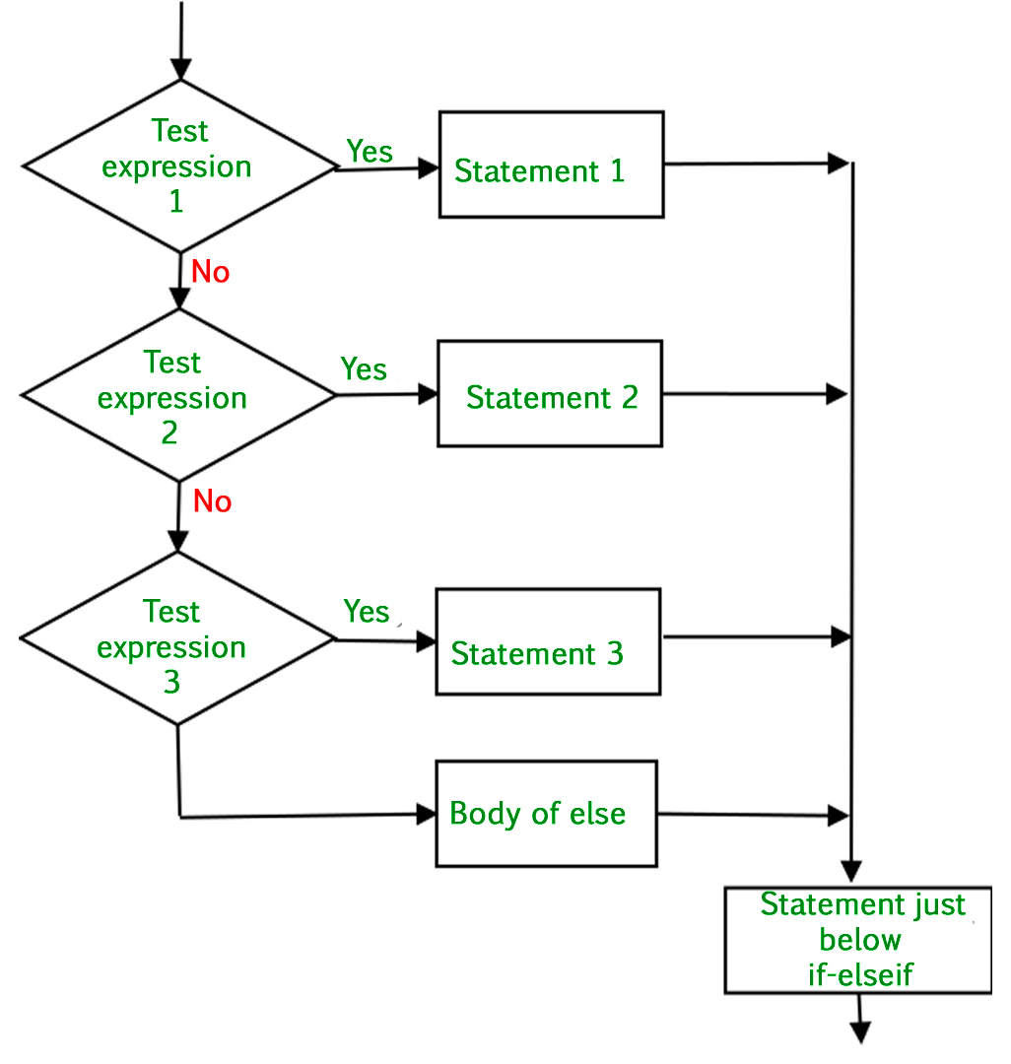
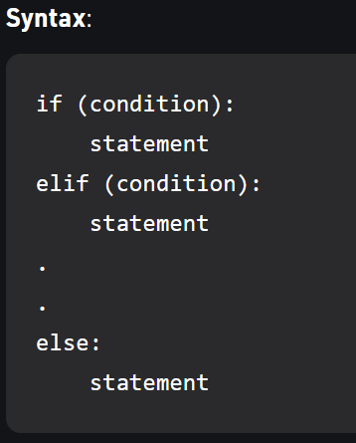
if-elif-else ladder
The if statements are executed from the top down. As soon as one of the conditions controlling the if is true, the statement associated with that if is executed, and the rest of the ladder is bypassed. If none of the conditions is true, then the final else statement will be executed.

Slide 53
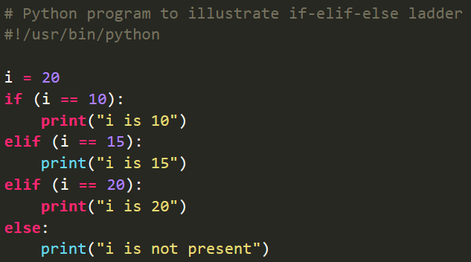
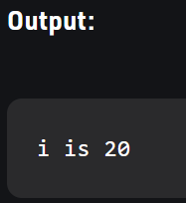
Example of if else elif statements

Slide 54
Python Function
A function is a block of organized, reusable code that is used to perform a single, related action. Functions provide better modularity for your application and a high degree of code reusing.
Defining a Function
Function blocks begin with the keyword def followed by the function name and parentheses ( ( ) ).
Any input parameters or arguments should be placed within these parentheses. You can also define parameters inside these parentheses.
The first statement of a function can be an optional statement - the documentation string of the function or docstring.
The code block within every function starts with a colon (:) and is indented.
The statement return [expression] exits a function, optionally passing back an expression to the caller. A return statement with no arguments is the same as return None.

Slide 55
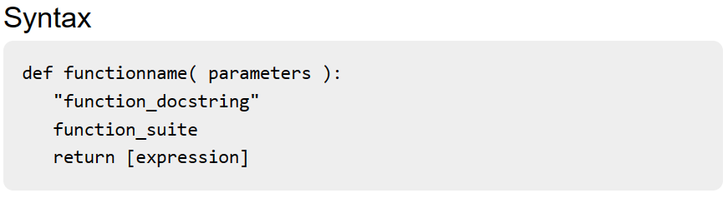
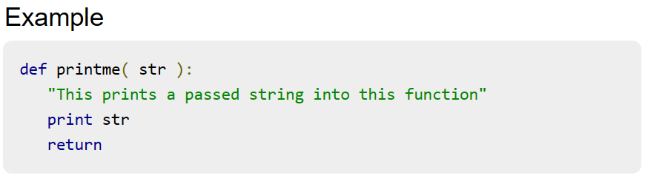
Syntax to define a function

Slide 56
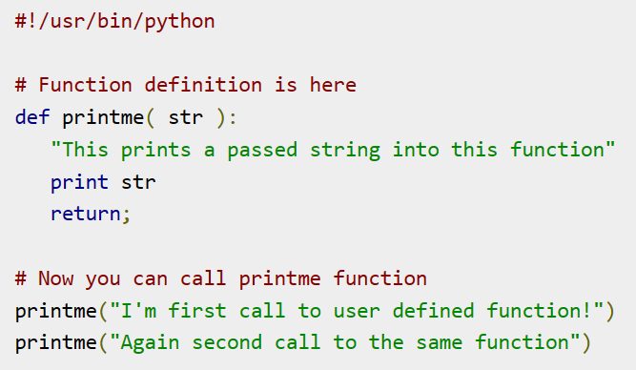
Calling a Function
Defining a function only gives it a name, specifies the parameters that are to be included in the function and structures the blocks of code.
Once the basic structure of a function is finalized, you can execute it by calling it from another function or directly from the Python prompt.

Slide 57
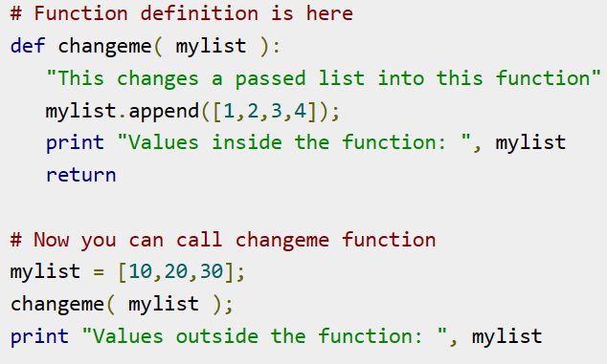
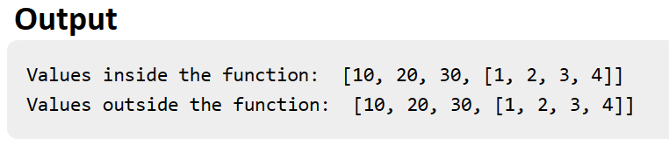
Pass by reference vs value
All parameters (arguments) in the Python language are passed by reference. It means if you change what a parameter refers to within a function, the change also reflects back in the calling function.

Slide 58
Function Arguments
There are three type of function arguments
Required arguments
Keyword arguments
Default arguments
Required arguments
Required arguments are the arguments passed to a function in correct positional order. Here, the number of arguments in the function call should match exactly with the function definition.

Slide 59
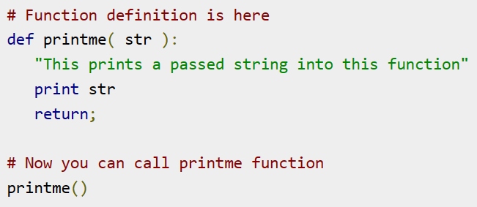
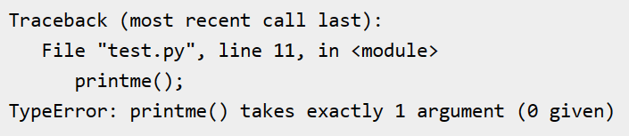
Example of Required arguments
Input Output

Slide 60
Function Arguments
Keyword arguments
Keyword arguments are related to the function calls. When you use keyword arguments in a function call, the caller identifies the arguments by the parameter name.
This allows you to skip arguments or place them out of order because the Python interpreter is able to use the keywords provided to match the values with parameters.
Default arguments
A default argument is an argument that assumes a default value if a value is not provided in the function call for that argument.

Slide 61
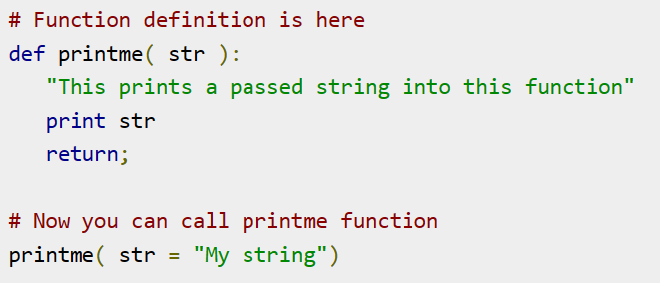
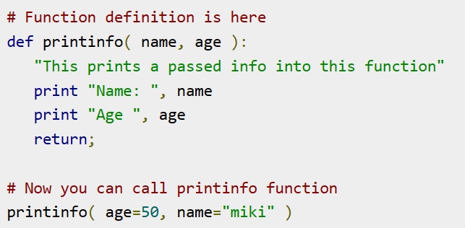


Example of Keyword arguments
Input Input
Output Output

Slide 62
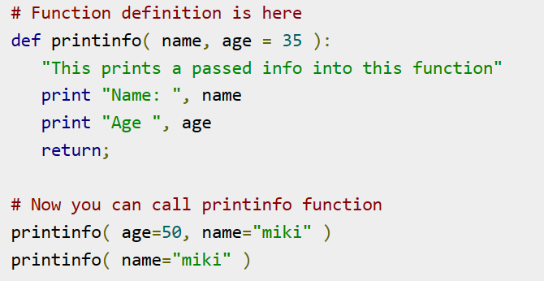
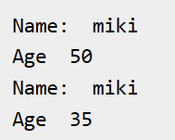
Example of Default arguments
Input Output

Slide 63
Thank You

